Slide 1
Decentralized Agricultural Supply Chain DApp
Çağrı Arslantürk 30892

Slide 2
GOAL of the Project
Revolutionizing the agricultural supply chain by empowering farmers and for that using blockchain technology.
Empower farmers by giving direct access to markets and fair profits by sharing all revenue.
Ensure transparency and traceability in all transactions which lead to a chance of going back to a products origins.

Slide 3
Motivation
Traditional agricultural supply chains often marginalized farmers. Farmers who are the producers and highest shareholders of the supply chain get treated unfairly.
Middlemen unfairly becomes owner of the profits.
Consumers lack transparency regarding product origins and quality.
Blockchain can provide a decentralized, transparent, and fair solution.

Slide 4
Key Components of the project
AgriToken (ERC20 Token): A utility token used for all transactions within the platform.
User Roles:
Different roles include Farmers, Suppliers, and Service Providers.
Role-based access control ensures that only authorized users can perform certain actions.
Product Registration:
Allows farmers to register their agricultural products on the blockchain.
Includes detailed information such as name, location, quality, and quantity.
Rewards farmers with AgriTokens for each registered product.

Slide 5
Key Components Continue
Marketplace:
A decentralized platform where registered agricultural products can be bought and sold.
Facilitates direct transactions between farmers and suppliers/consumers.
Service Providers:
Providers offer farming tools, seeds, fertilizers, and other necessary resources.
Farmers can purchase these resources using AgriTokens.
Governance:
A decentralized decision-making process.
Stakeholders can propose and vote on changes to the platform.

Slide 6
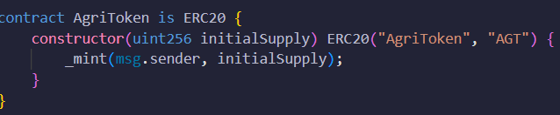
AgriToken
Utility token for transactions within the platform.
Standard ERC20 token.
Minted with an initial supply.

Slide 7
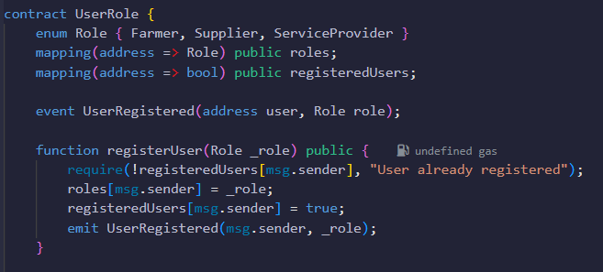
User Roles
Registers User to the system.
Roles: Farmer, Supplier, Service Provider

Slide 8

registerUser : Registers a user with a specific role if they are not already registered.
onlyRole : Modifier that restricts access to functions based on the user's role.

Slide 9
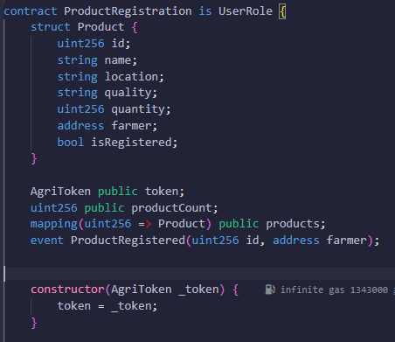
ProductRegistration
Allows registration of products on the blockchain.
Constructor: Initializes the contract with the address of the AgriToken contract.

Slide 10
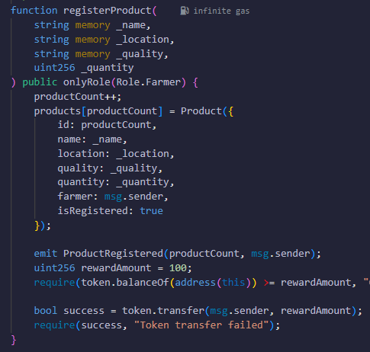

registerProduct:Registers a new product with detailed information and rewards the farmer with tokens.
getProduct: Returns the details of a product by its ID.

Slide 11
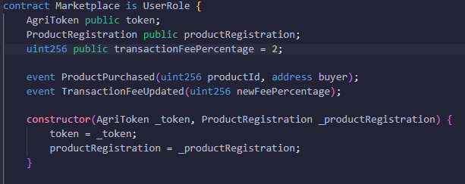
MarketPlace
Facilitates the buying and selling of registered agricultural products using AgriTokens.
Constructor: Initializes the contract with the addresses of the AgriToken and ProductRegistration contracts.

Slide 12
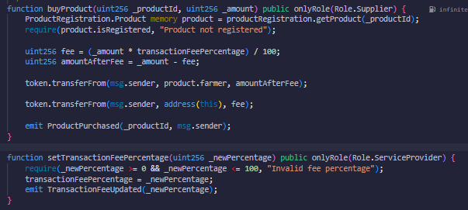
buyProduct: Allows suppliers to purchase registered products, applying a transaction fee and transferring tokens.
setTransactionFeePercentage:Allows service providers to update the transaction fee percentage.

Slide 13
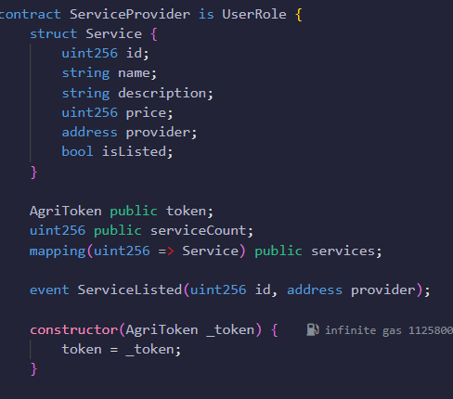
Service Provider
Manages the listing and purchase of services for farmers and suppliers.
Constructor: Initializes the contract with the address of the AgriToken contract.

Slide 14
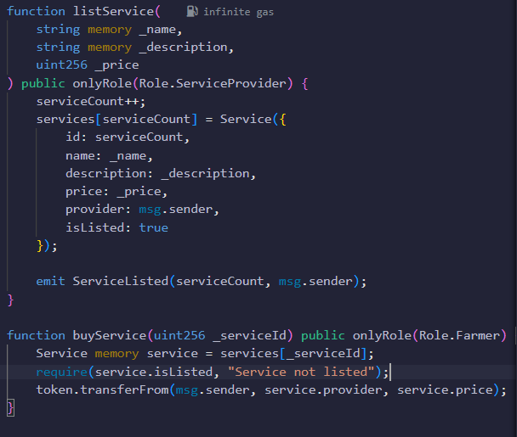
listService: Allows service providers to list their services.
buyService: Allows farmers to purchase listed services using AgriTokens.

Slide 15
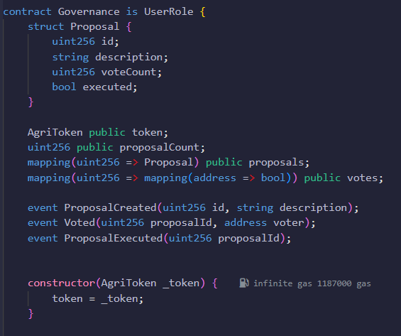
Governance
Implements a decentralized decision-making process for platform changes.
Constructor: Initializes the contract with the address of the AgriToken contract.

Slide 16
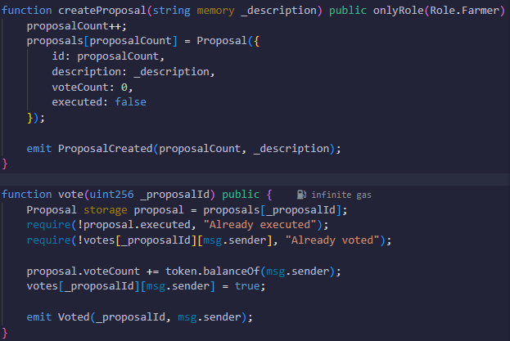
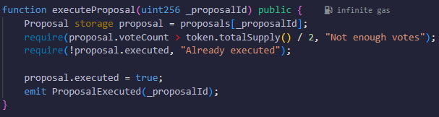
createProposal: Allows farmers to create proposals for platform changes.
Vote: Allows stakeholders to vote on proposals.
executeProposal: Executes proposals if they receive enough votes.

Slide 17
A Sample Demo Run
After deploying all the files we can create new users with different accounts using UserRole.sol
We can choose it by writing 0,1,2,3 because we use enum.
We should Create a farmer then transfer some tokens to ProductRegister.sol by using transfer function on the AgriToken.sol.
Now with the farmer Account we can register new product which we can check the product id. If it is the first registered product then product id is 1.
After that with our initial account we can call MarketPlace.sol and then with suppliers account we can buy the product that farmer registered.

Slide 18
In the process mentioned before we can use other features of the smart contracts, For example:
We can form a Service Provider with different account.
We can use governance features.
Etc.

